Slide 1

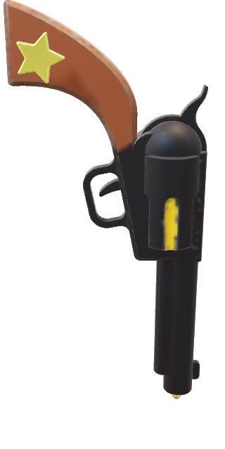

MSIM 742
Mark Brosche’s
Shooting
Gallery

Slide 2

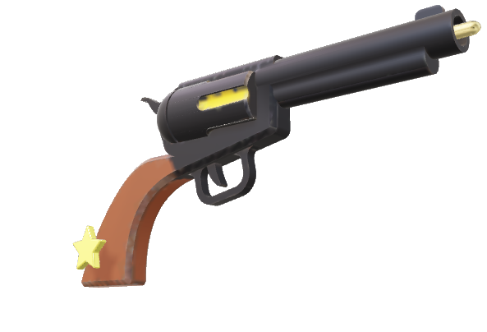

MSIM 742
Mark Brosche’s
Shooting
Gallery

Slide 3
MSIM 742
Mark Brosche’s
Shooting
Gallery

Slide 4
MSIM 742
Mark Brosche’s
Shooting
Gallery

Slide 5

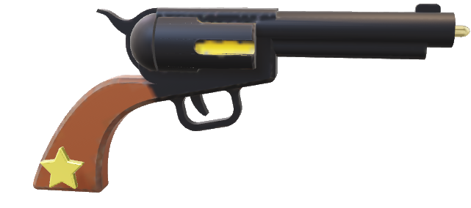
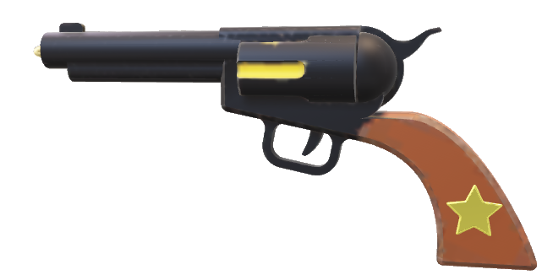
Mark Brosche's 2nd Assignment:
Shooting Gallery
Targets
That Way
Targets
That Way

Slide 6
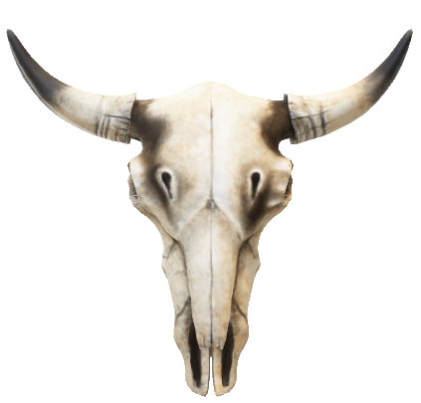
WINNER

Slide 7

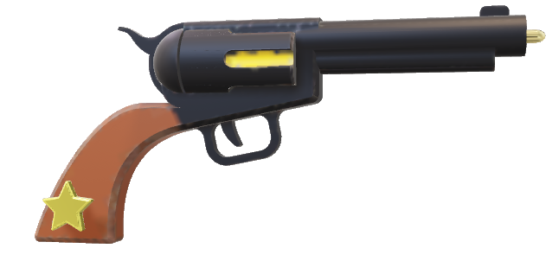
Mark Brosche's 2nd Assignment:
Shooting Gallery
BANG!!!

